Slide 1
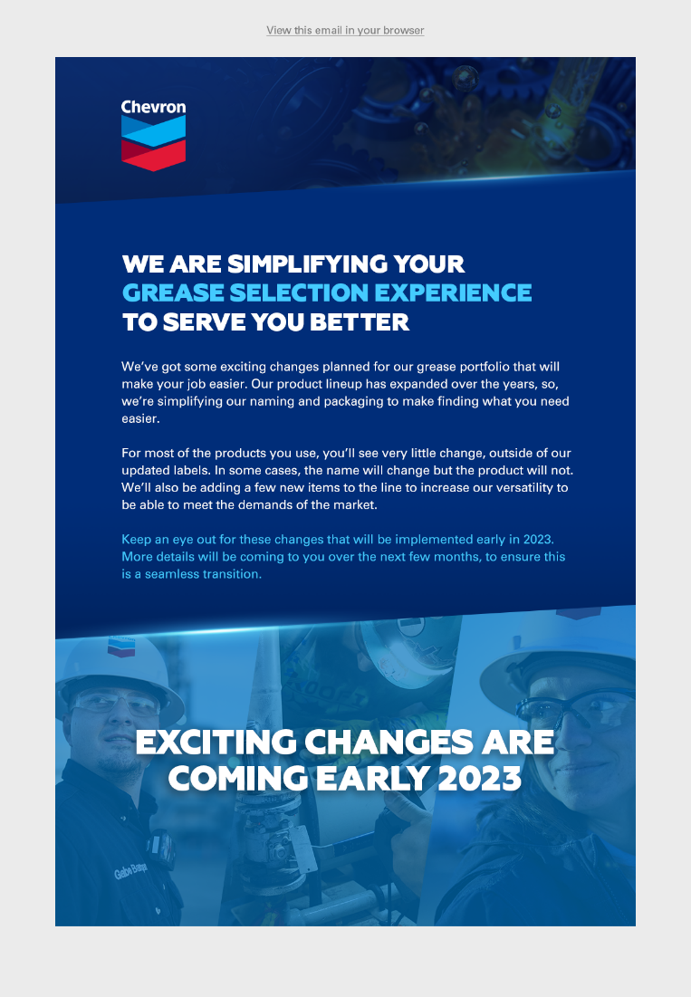
Email
Notes:
Text:
We Are Simplifying Your Grease Selection Experience to Serve You Better
We’ve got some exciting changes planned for our grease portfolio that will make your job easier. Our product lineup has expanded over the years, so, we’re simplifying our naming and packaging to make finding what you need easier.
For most of the products you use, you’ll see very little change, outside of our updated labels. In some cases, the name will change but the product will not. We’ll also be adding a few new items to the line to increase our versatility to be able to meet the demands of the market.
Keep an eye out for these changes that will be implemented early in 2023. More details will be coming to you over the next few months, to ensure this is a seamless transition.

Slide 2

Graphic for LinkedIn

Slide 3



Graphics for ChevronLubricants.com (three image rotation):

