Slide 1
Account Planning for Chevron Lubricant Marketers
Colleen Francis and Amit Patel
March 12, 2021

Slide 2
First Source Account Plan Requirement + Support
Requirement: Account Plans completed for 5 most strategic accounts, leveraging BC/BDS for support
Rollout Plan
Training Webinar and BC/BDS Support
How:
When:
What’s covered:
Mar 12, 2021
Account planning process expectations
Minimum requirements for an Account Plan template if you have one of your own
Chevron recommended account plan template and how to complete it
What "good" and "not so good" looks like
Risks and Mitigations
Recording completion for First Source tracking purposes
Notes:
Webinar will be recorded but we would encourage LM managers to attend and get their teams to attend
BCs/BDSs support the LM seller in the completion of the plan but the LM drives it.

Slide 3
Roles + Responsibilities
Role | Responsibility
LM Sales Manager | Ensures account segmentation is properly applied Coaches' seller in the development of the account plan Follows up with seller to ensure plan is being executed and helps adjust the plan as necessary during coaching calls
LM Seller | Assigns accounts to the appropriate segment Completes draft of account plan Review with internal stakeholders – leadership team – for review and updates Delivers value through projects, products, services Adjusts plan as necessary through the year Documents value delivery Communicates value delivered through routine business reviews
Chevron BC/BDS | Coaches LM team in the development of the account plan Supports LM seller in: Delivering value through projects, products, services Adjusting plan as necessary through the year Documenting value delivery Communicating value delivered through routine business reviews Ensures an account plan is complete for top 5 strategic accounts Ensures a business review is conducted for the top 5 accounts

Slide 4
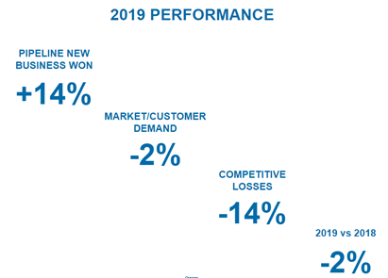
Guiding Principles – Why Care About Account Planning?
Without it we are “Running in Place”

Slide 5
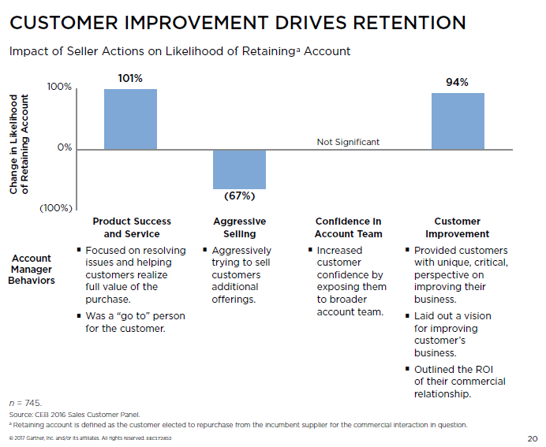
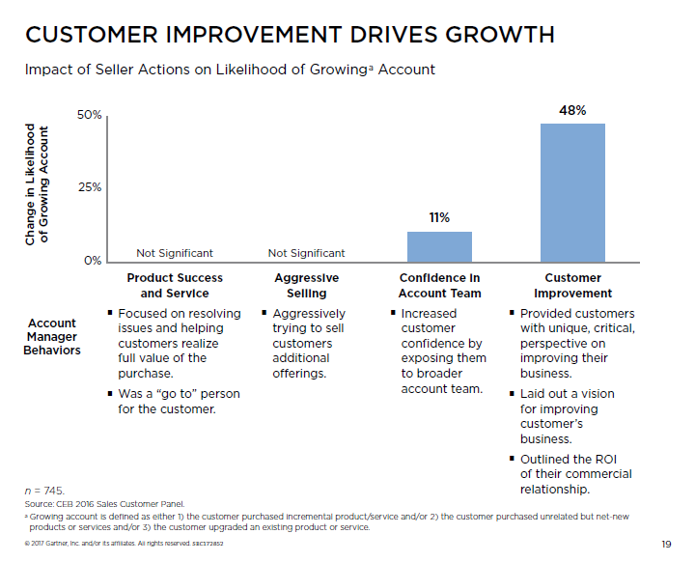
Guiding Principles – Why Care about Account Planning?

Slide 6
Common Pitfalls
Account Plans are not documented in one place
Account Plan not reviewed once created and/or is not active
Sellers are stuck as “Relationship Sellers” heavily reliant on their one primary contact
We already do this!
Busy sellers take a “No news is good news” approach to account Management
A “route selling” mentality rather than strategic territory management
Compensation Plans and Cultures that reward Hunting over Retention and Growth
Limited definition of retention. IE Volume vs Margin

Slide 7
High Engagement
Document & share ROI
Continually build new relationships
Consistently enhance existing relationships
2 biz review a year
QBR + AP updates
Align business initiatives with your solutions
Teach new insights
Document and share ROI
Expand contact base
Maintenance/Protect
Key Account /High Growth
Low Growth Potential
High Growth Potential
Transactional
High Potential /Growth
Build your organizational chart
Introduce your own team members
Onboarding check in
Regular BIC an RBL to prove progress
Virtual Selling
React professionally and timely
Use technology for communication
Listen for expansion opportunities
Low Engagement

Slide 8
Knowing the Stakeholders
CLIENT INFORMATION
Influencers and Buyers
Enter these people as Contacts in your CRM with title and email address
Title | Name | Influence level (1-10, 1 low, 10 high) | Talker / Blocker / Mobilizer | Leverage / Neutralize / Motivate | Actions to develop relationship
Manager Coaching Tips:
Require a minimum number of active contacts per account type
This should be a dynamic part of the Account Plan
Ask:
  Who is the back up?
  Who is the operations contact? Who do I drivers need to coordinate with? Who runs finance?

Slide 9
What Good Looks Like
Title | Name | Influence level (1-10, 1 low, 10 high) | Talker / Blocker / Mobilizer | Leverage / Neutralize / Motivate | Actions to develop relationship
Sourcing Manager | Jennifer K | 9 | Blocker | Motivate | Develop relationship through specific engagements
Sourcing Specialist | Rachel J | 6 | Mobilizer | Leverage | Collaboratively plan and influence to meet w/ Manager
Maintenance Manager | David M | 4 | Talker | Motivate | Share ROI from the last RBL
Aftermarket Manager | Claire T | 4 | Blocker | Neutralize | Address concerns at upcoming sourcing meeting
Look for:
A mix of influence levels
At least one blocker – there is always at least one!
Actions could include using resources from other departments or Chevron
Clear measurable actions that the seller can be responsible for
Coaching Moment: “Develop relationship through specific engagements”
  What are those specific engagements?

Slide 10
Strategic Thinking: Account Based 3x3x3
What are the key market drivers and trends that this client is facing? (e.g., political, economic, social, technology, laws & regulations, environmental, etc.)?
What are the Client’s key business initiatives (e.g., profitability expansion, acquisition, green, new product development)?
Based on your experience with other similar businesses, what should the client be thinking about that they are not currently considering (product consolidation, ash build up, vendor consolidation, extended equipment / parts life, preventative maintenance programs etc.)
Manager Coaching Tips:
Use the Pre Call Plan 3x3x3 as inspiration, as well s the Trends documentation
Ensure sellers are not using a solution in place of an initiative.
  Eg: Reducing oil cost is a solution not an initiative
Ask “why they care about that?” to elevate the initiative

Slide 11
What Good Looks Like
What are the key market drivers and trends that this client is facing? (e.g., political, economic, social, technology, laws & regulations, environmental, etc.)?
Stringent emissions regulations on portable equipment
Increasing construction activity driving equipment sales
IoT driving digital information available for proactive maintenance practices
What are the Client’s key business initiatives (e.g. profitability expansion, acquisition, green, new product development)?
Grow in both new and traditional ways. Diversify their revenue sources profitably
    One idea is to create more value in their warranty program to increase profits
Avoid commoditization, and effectively combat growing competitive programs
Improve Green initiatives and reduce carbon footprint by 10%
Based on your experience with other similar businesses, what should the client be thinking about that they are not currently considering (product consolidation, ash build up, vendor consolidation, extended equipment / parts life, preventative maintenance programs etc)
Creating differentiation from the competition not just “combatting it”
Total lifetime value of their equipment
The connection between customer productivity (uptime) safety and profits

Slide 12
Align Trends and Initiatives with Insights and Solutions
Identify Insights or Commercial Teachings that we can offer to align with the 3 X 3 X 3 information above.
Trend or Initiative | Insights | Product/Service/ Project | Clients level of awareness (H/M/L) | RBL Expected Value to Customer
Improve Green initiatives and reduce carbon footprint 10% | Local production and distribution, reduced ash, reduced oil consumption, less waste, vendor reduction | Vartech, 15W30, vendor consolidation, product consolidation, preventative Maintenance program | M | $40,0000/year
TOTAL GROWTH POTENTIAL FOR OUR PRODUCTS (VOLUME OR MARGIN)
Based on the solutions proposed above, what is the sales growth potential for this Customer over the next year?
8,000 gal growth potential
Manager Coaching Tips:
Create Multi Threaded value with multiple insights per trend
Multiple insights should address multiple stakeholders
Services can also be non product related

Slide 13
Retention and Growth Acitivites
What are the specific activities you will undertake to engage with the Customer to deliver insights and create awareness for the solutions above?
Influencer / Buyer | Activity | Responsibility | Time Frame
Jennifer K | Discuss ISOCLEAN with sourcing manager who is a strong adversary of ISOCLEAN. Reposition the ISOCLEAN product - rather than life extension and end user value; talk more POP focused around differentiation (visually for the customer), create the question in their mind of what is clean, and margin improvement for ABC | Seller | Mar 2021
Claire T | Set up series of engagements with OEM Tech Services to improve awareness of value sell opportunities. | Seller | Apr-Jun 2021
Manager Coaching Tips:
Make sure the activity is measurable.
  “Series of engagements” should be spelled out
“the first activity should include discussing ISOCLEAN with others that need to be brought on board
Set up tracking to measure when the activities are completed
Additional contacts should be added each time an activity is completed

Slide 14
Measuring Success
DELIVERING VALUE TO THE CUSTOMER
What value have we delivered this year and how did it compare to the expected value?
Product/Service/Project | Original RBL Expected ROI | Actual ROI to Date | +/- %
Drain extension | $25,000 | $30,000
ISOCLEAN Small Pack Differentiation Offering | $40,000 | $20,000
Re-establishing Partnership Despite Turnover | $20,000 | $5,000
Annual Total | $85,000 | $55,000
Manager Coaching Tips:
Are you measuring success in an ongoing fashion
Are you measuring all areas of value?

Slide 15
Communicating Value
VALUE COMMUNICATION
What is our plan to communicate this value to the customer?
Product/Service/Project | Buyer / Influencers Involved | Activity | Time Frame
ISOCLEAN Small Pack Differentiation Offering | Sourcing Manager, Aftermarket Team | Set up meeting to review margin improvement from small pack offering | Q4
Re-establishing Partnership Despite Turnover | Aftermarket Team | Mid-year review scheduled | June
Manager Coaching Tips:
“We are great at knowing what value we deliver to the customer, and terrible at telling the customer what that value is”
Regular value communication is important
Coach sellers to be comfortable sharing value that dones’t have a dollar value associated with it.
  Reduction in failures
  Safety

Slide 16
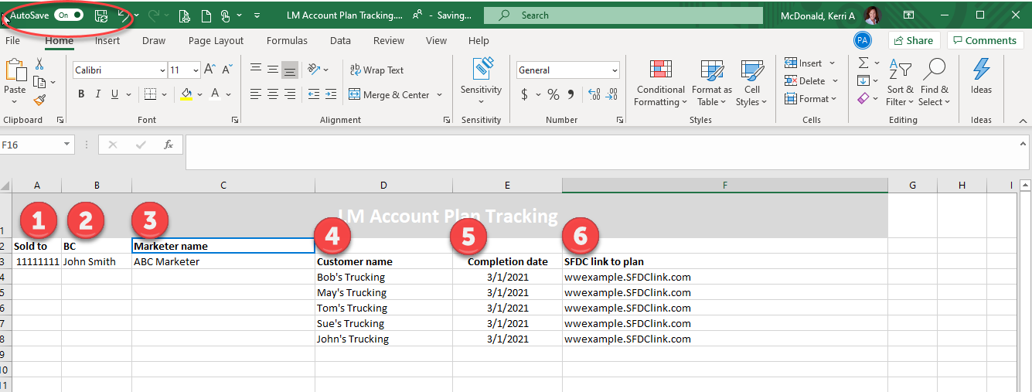
How to Document the Completion of Account Plans
Access tracking document in Teams>Lubricants Marketer Channel>General channel
Find your marketer, enter the customer name, completion date, and if applicable the link to the plan

Slide 17

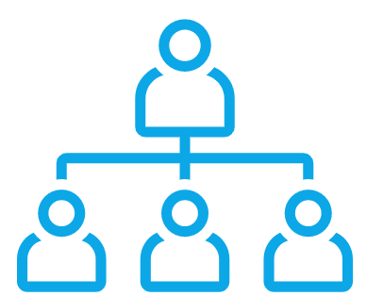



Account Plan Template – Minimum Requirements
  A grouping of accounts that differentiates between more and less important accounts based on criteria such as growth potential, engagement, current revenue/profitability, etc.
  Segmentation should define how often to conduct business reviews with the customer and whether or not an account plan is required.
  We recommend you use the segmentations provided in Accelerate
Account segmentation
  A list or graphic that captures customer stakeholders, their title, whether they are a talker/blocker/mobilizer, and the current relationship status (eg - strong/neutral/weak).
  Plan must include actions to develop or use the relationship to further customer/LM goals
Buyer Map
3x3-like section
  An outside in view of the customer to document
    Trends affecting the customer
    High level customer objectives
    Opportunities they may be missing (initial hypothesis of a reframe)
Projects
Identify the key projects/products/services that will be delivered that align with the opportunities
Documented Value
  Communication of documented value delivery from the projects/initiatives
  A plan to share that value with the customer

Slide 18
Next Steps
Start Implementing immediately so that you receive the full benefit of Account Planning in 2021
Take recording, and materials and work review with your team
Accelerate Graduates – review Phase 5 materials with your team again!
Schedule internal QBR review sessions for each of the Account Plans and measure results
Use your BC/BDS team to help

