Slide 1
Customizable Inside Out Protection Diagram
Instructions for Use
Page 2 of this document includes all of the recommended products for Surface Mining. To create a custom recommendation for your customer, please use page 3 of this document to:
Add your customer’s name at the top and change the color to dark gray (R:89, G:89, B:89) or use the Format Painter function to match the rest of the header.
Insert your customer’s logo in the bottom left. If you don’t have a logo, just remove the box that says Insert Company Logo Here.
Fill in each product recommendation by replacing the red ? for each component with the recommended product(s).
Delete pages 1-2 of this document prior to sending electronically to your customer. (Keep a copy of this entire document for future use.)
We highly recommend that you save a copy of your “FINAL” as a PDF vs. sending out the original PowerPoint slide so that it can not be edited by your customer.

Slide 2
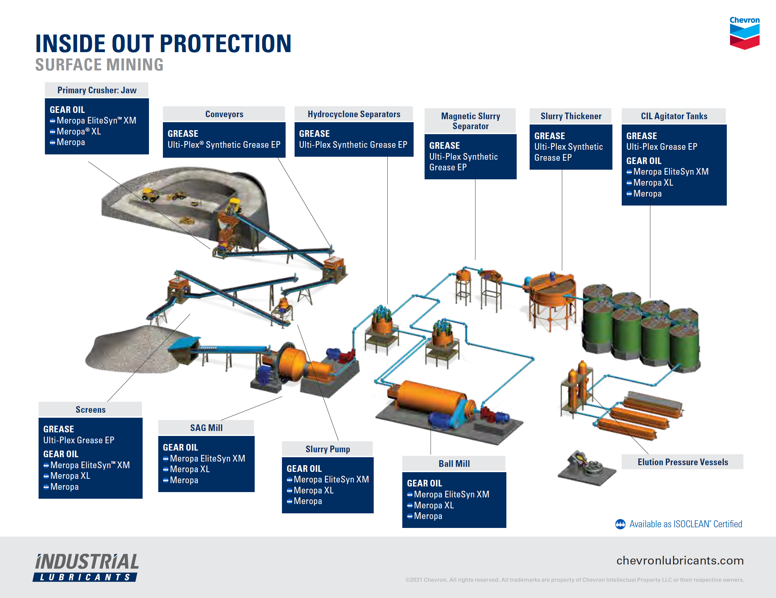

Slide 3
Inside Out Protection Product Recommendation For ABC Company
Primary Crusher: Jaw
?
Conveyors
?
Hydrocyclone Separators
?
Magnetic Slurry Separator
?
Slurry Thickener
?
CIL Agitator Tanks
?
Screens
?
SAG Mill
?
Slurry Pump
?
Ball Mill
?
Insert Company Logo Here

