Slide 1
Havoline® Full Synthetic Multi-Vehicle ATF Product Overview
Chevron Sales Team
April 2022

Slide 2
Agenda
Product and Market Information
  Market Dynamics
  Product Overview
  Product Details
  Product Approvals
Proven Technology
ATF Product Coverage
Appendix

Slide 3
Product and Market
Information

Slide 4
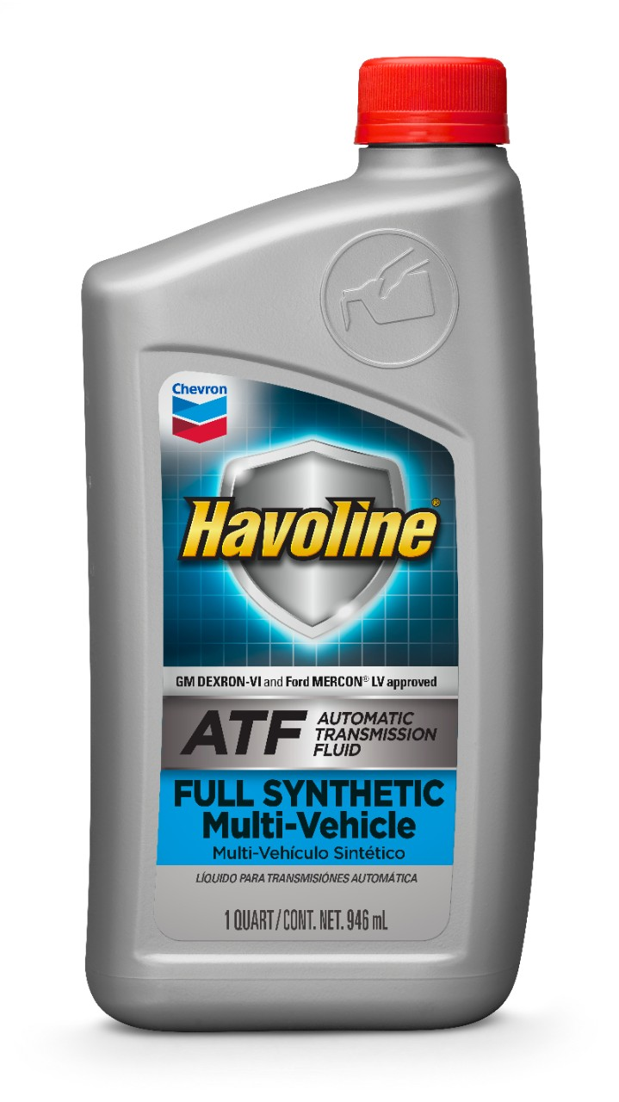
New Product Introduction: Havoline® Full Synthetic Multi-Vehicle Automatic Transmission Fluid (ATF)
Premium, full synthetic ATF
  Low viscosity formulation
  Superior friction control
Dual license
  approved for use in GM DEXRON® VI and Ford MERCON® LV transmissions and transaxles
  GM and Ford are the only NA OEMs that grant service fill ATF approvals
Available in US and Canada
NEW

Slide 5
ATF Market Dynamics
Complexity - virtually every ATF is OEM-specific
  In some cases, specs are specific to vehicle series or transmission manufacturer (OEM tier-1 supplier)
Changing Consumer Preference
  Continued demand for Do-It-For-Me (DIFM) oil change services vs. Do-It-Yourself (DIY)
  DIFM channel accounts for ~75% of NA volume
Quick lubes account for 1/3 of DIFM channel volume
  Demand and channel mix appears stable for foreseeable future
Source: Kline & Company

Slide 6
Addressable Market Size
Covers large, addressable market…along with Havoline Multi-Vehicle Global ATF
  61.6% of total NA car parc
Global Multi-Vehicle ATF Product: 13.3% of total vehicles
Full Synthetic Multi-Vehicle ATF Product: 48.3% of total vehicles
Source: Polk (Q3, 2020 data)

Slide 7
How Does Havoline Full-Synthetic Multi-Vehicle ATF Compare with Other Products in the Portfolio?
Havoline Full-Synthetic Multi-Vehicle ATF | Havoline Global Multi-Vehicle ATF | Havoline ATF MD-3
New product as of 2022 Premium, full synthetic formulation | Cost-effective Synthetic-blend formulation | Cost-effective Mineral formulation
For vehicles still under warranty (excludes Chrysler and Ford Type F vehicles) | For post-warranty vehicles (excludes Chrysler and Ford Type F vehicles) | *Ford and GM vehicles older than MY 2006 (* excludes ATF Type F)
Dual-licensed for use in any vehicles requiring Ford MERCON-LV or GM DEXRON®-VI approval | Meets GM requirements for any vehicle specifying DEXRON, DEXRON-II, DEXRON-III, and DEXRON-VI | Meets requirements of Ford MERCON and GM DEXRON-III
Recommended for most high and low viscosity import vehicles including Audi, BMW, Honda DW-1, Hyundai SP-IV, Nissan Matic S and Toyota WS | Suitable for use in 99% of automatic passenger cars and some medium and heavy-duty vehicles (consult the PDS or Havoline ATF guide for more details) | Recommend for Ford and GM vehicles specifying MERCON, DEXRON, DEXRON-II or DEXRON-III

Slide 8
Why Carry a Dual-Licensed ATF?
End-use consumers are rapidly moving to higher quality, full synthetic lubricants endorsed by OEMs
  Dual-licensed products are specifically formulated to meet the needs of the growing low viscosity multi-vehicle ATF market
Vehicles specifying Ford MERC-LV and GM DEX-VI specs are expected to grow to +30% of North America car parc by 2024
No +MY2009 Ford vehicle specifies MERCON or MERCON V
  Ford began using MERCON® LV with introduction of six-speed transmissions for 2009 model year
  These transmissions are now beginning to reach their recommended 150,000 mile drain interval.
  The added MERCON® LV license can bolster service-fill ATF sales

Slide 9
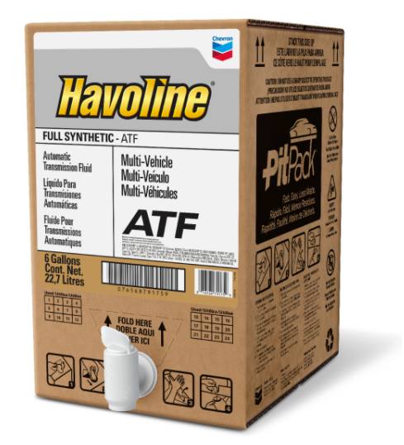
Product Overview
Premium, full synthetic ATF
  Low viscosity formulation
Dual license approval
  Ford MERCON® LV and General Motors DEXRON®-VI
  Also exceeds the requirements of JASO 1A-LV
Friction control and performance
  Maintains friction control and excellent friction performance for smooth and consistent shifting without any shudder as the fluid ages in the transmission
Oxidation stability and wear protection
  Keeps transmission cleaner and reduce its noise and vibration.
  Enable transmission to last longer by providing excellent oxidation stability and superior protection of its components from wear and degradation over a wide range of temperatures.
Shear stability with exceptional lubrication
  Retains fluid viscosity and physical properties.
  Provides efficient power transfer from engine to wheels at high temperatures.

Slide 10
Key Product Benefits
Peace of mind
  Approved fluid for GM DEXRON-VI and Ford MERCON-LV applications - offers warranty coverage for vehicles that specify these specifications
Broad coverage
  Backward compatible with all applications that require GM DEXRON-III, DEXRON-II and DEXRON specs
  Also recommended for Toyota, Honda, Hyundai vehicles and many other import vehicles
Maximize transmission life
  Advanced formula made with high purity synthetic base oils resists foaming and protects transmission against wear, corrosion, and sludge formation
Lower maintenance costs
  Superior high temperature and anti-oxidation properties help protect the transmission and keep it clean during extended drain intervals
Improve fuel economy
  Low viscosity formula reduces transmission drag and improves efficiency to help maximize fuel economy
Save money with proven technology
  Proven to work with modern vehicles through extensive testing, so there's no need for supplemental additives or top treats
Chevron does not recommend Havoline Full Synthetic Multi-Vehicle ATF for use in vehicles with continuously variable transmissions (CVTs) or dual clutch transmissions (DCTs). Havoline Full Synthetic Multi-Vehicle ATF is not recommended for transmissions where Ford Type F, MERCON, MERCON V, MERCON SP, MERCON ULV is specified.

Slide 11
Product Details
Packages
  Quart
  PitPack
  Drum
  Bulk
Market Availability
  US
  Canada
Product Number
  226536

Slide 12
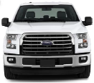
Product Approvals
General Motors DEXRON®-VI
  Licensed for most GM automatic cars*
  Recommended for any car specifying DEXRON, -II, -III and -VI specs
Ford MERCON® LV
  Licensed for all +MY2009 Ford automatics (ex. 9-10 spd)
  Not recommended for MERCON, -V, -SP and -ULV
JASO M315 1-A-LV13
  Certified for increasing modern imported vehicles
  Covers JASO M315 1-A and 1-A-LV applications
*except for GM vehicles specifying DEXRON HP or ULV

Slide 13

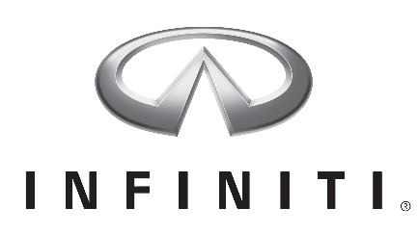
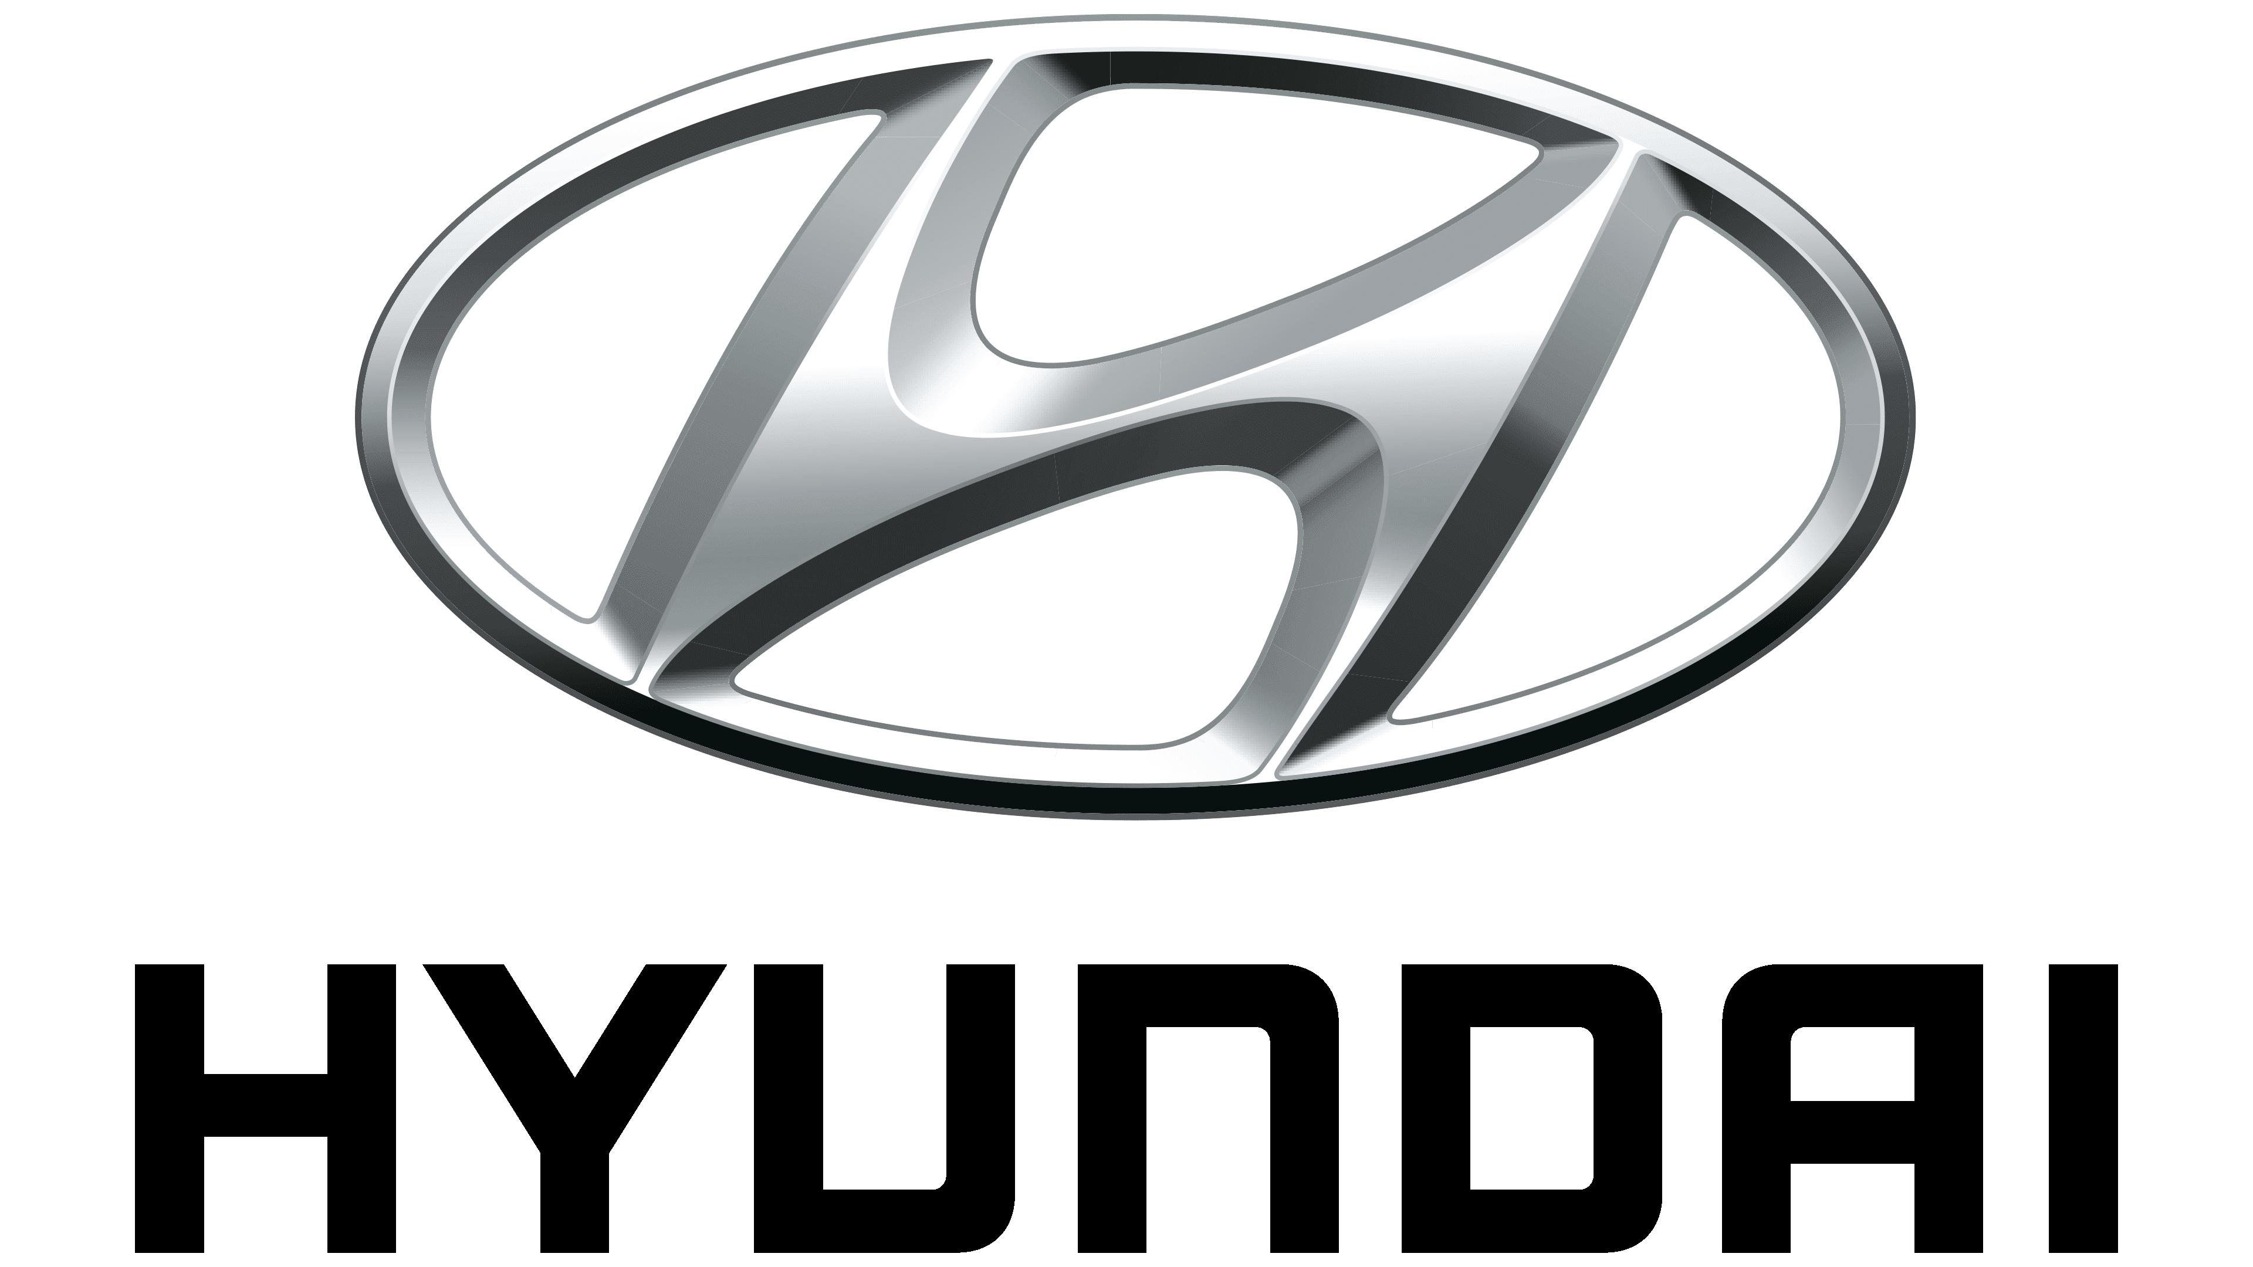



Import Vehicle Coverage
Proven performance in +6 speed automatics specifying these low viscosity fluids
  JASO: M315 Type 1A
  Toyota: Type WS (JWS 3324)
  Nissan: Matic-S
  Hyundai: Diamond SP-IV
  Honda: DW-1
  ZF: 6, 8 and 9 Speed Transmissions
  Mercedes Benz: MB 236.12/14

Slide 14
Proven Technology

Slide 15
Proven Technology
Product performance is validated for most OEM and transmission manufacturers
ATF performance is evaluated by combination of
  Published/available specifications
  Industry standard bench tests
  Vehicle tests - by Mileage Accumulation Dynamometer (MAD) or field trial
ATF claims are developed according to core OEM specifications and common transmission types supplied by transmission manufacturers (OEM tier-1 suppliers)

Slide 16
Extensive Testing To Support Claims
Mileage Accumulation Dynamometer (MAD) Evaluations
GM DEXRON-VI Field Trial
Ford MERCON LV Field Trial
Import Vehicle Field Trials

Slide 17
MAD & Field Trial Evaluation Overview
MAD and bench test completed at independent facilities
  Intertek and Southwest Research Institute
Hardware and fluid properties met critical performance criteria set by OEMs during MAD and field trials
  Viscosity
  Oxidation
  Wear protection
  Shift feel
  Anti-shudder

Slide 18
GM DEXRON-VI Field Trial - Overview
Ten 2007 Chevrolet Uplanders were field tested for 150K miles
Periodic oil sampling & ride evaluations were conducted
No driver complaints or abnormal findings during or end of test
Rigorous field test at extended drain interval of 150K miles conducted with negligible bare elements detected:
  Iron (Fe)
  Copper (Cu)
  Lead (Pb)
  Tin (Sn)
  Aluminum (Al)
  Silicon (Si)
Results were approved by GM for DEXRON® VI
*See Appendix for Oil Analysis and EOT Inspection Details

Slide 19
Ford MERCON LV Field Trial - Overview
Eight Ford F-150 trucks were field tested for 100K miles
Periodic oil sampling & ride evaluations were conducted
No driver complaints or abnormal findings during or end of test
Rigorous field test at extended drain interval of 150K miles conducted with negligible bare elements detected:
  Iron (Fe)
  Copper (Cu)
  Lead (Pb)
  Aluminum (Al)
Results were approved by Ford for MERCON® LV
*See Appendix for Oil Analysis and EOT Inspection Details

Slide 20
Low Viscosity ATF Applications
Extensive tests were completed to support “suitable for use” claims in various low viscosity applications
APPLICATION | Field Trial (miles) | Mileage Accumulation Dynamometer (miles)
Honda ATF-Z1, DW-1 |  | 20,000
Hyundai SP-IV |  | 11,000
Nissan Matic-S |  | 11,000
Toyota WS and T-IV |  | 11,000
Chrysler Type 9602 |  | 20,000
MB 236.12/14 |  | 10,000
ZF TE-ML 11 | 25,000

Slide 21
Product Coverage

Slide 22
ATF Product Coverage Overview
Coverage details for:
  DEXRON-VI
  MERCON LV
  JASO M315
  ZF
  Honda
  Hyundai
  Nissan
  Toyota
  Toyota WS and T-IV
  Mercedes-Benz
  Chrysler

Slide 23
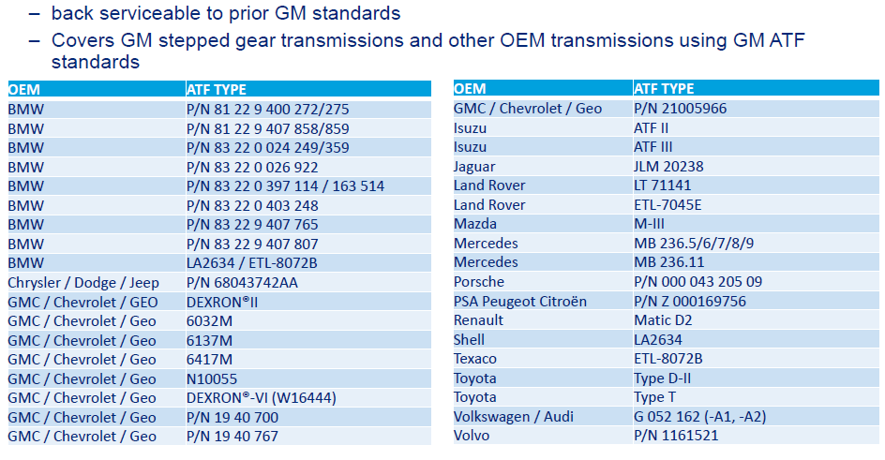
DEXRON-VI ATF Family Coverage

Slide 24
MERCON LV ATF Family Coverage
OEM | ATF Type
Ford / MERCON LV / Motorcraft® | PN XT-10-QLVC
Ford / MERCON LV / Motorcraft® | PN XT-10-5Q3LV
Ford / MERCON LV / Motorcraft® | PN XT-10-DLV
Ford / MERCON LV / Motorcraft® | PN XT-10-6GLV

Slide 25
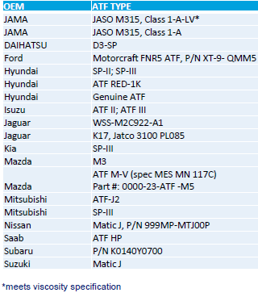
JASO M315 Type 1A-LV13 ATF Coverage
Covers most JAMA stepped gear transmissions:
JASO M315 Type 1A-LV13 and 1A have identical requirements except their fresh and after shear Kinematic Viscosity at 100C
Asian OEM specs meet this JASO spec:
  Honda ATF D-W1
  Hyundai SP-IV
  Nissan Matic-S
  Toyota WS and T-IV

Slide 26
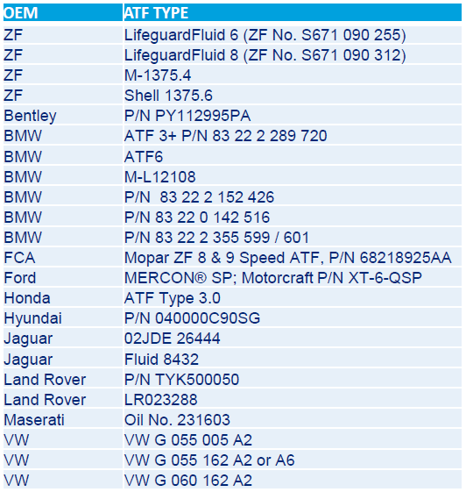

ZF ATF Family
Field trial with 3 cars using 8-speed ZF transmissions requiring ZF TE-ML 11 ATF (ZF 1375.8) was conducted for 25k miles
Interval evaluations compared against F/F ATF
  KV100 remained stable~5.5 cSt (Fresh KV100=6.0 cSt)
  No sign of oxidation observed (TAN <1.3 mg KOH/g)
  Negligible metals in EOT oil
  Satisfactory shift feel quality

Slide 27

Honda ATF Coverage
Honda ATF D-W1 is back serviceable to prior Honda ATF specs and OEMs using any Honda transmissions
2 MAD tests for 20k miles were conducted with interval evaluations comparing them w/ their F/F ATF Z-1 ATF
  KV100 remained stable>5.8 cSt (Fresh KV100=6 cSt)
  No observed signs of oxidation (TAN <0.8 mg KOH/g)
  At 20K miles: wear was well below that of factory fill fluids, with equivalent original 20K miles
  Shift feel evaluations were satisfactory

Slide 28
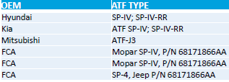
Hyundai ATF Coverage
2 MAD tests for 11k miles were conducted with interval evaluations comparing them w/ their F/F SP-IV ATF
  KV100 remained stable>5.8 cSt (Fresh KV100=6 cSt)
  No observed signs of oxidation (TAN <0.8 mg KOH/g)
  At 20K miles: wear was well below that of factory fill fluids, with equivalent original 20K miles
  Shift feel evaluations were satisfactory

Slide 29

Nissan ATF Coverage
2 MAD tests with Nissan and Infinity cars were conducted for 11k miles with interval evaluations comparing them with their F/F Nissan Matic-S ATF
  KV100 remained stable>5.9 cSt (Fresh KV100=6 cSt)
  No observed signs of oxidation (TAN <0.8 mg KOH/g)
  Negligible metals (Fe, Cu, Al, Pb) found in EOT fluid
  Shift feel evaluations were satisfactory

Slide 30
Toyota ATF Coverage
2 MAD tests were conducted for 11k miles, with interval evaluations compared to their F/F Toyota WS ATF.
  KV100 remained stable>5.9 cSt (Fresh KV100=6 cSt)
  No observed signs of oxidation (TAN <0.8 mg KOH/g)
  Negligible metals (Fe, Cu, Al, Pb) found in EOT fluid
  Shift feel evaluations were satisfactory

Slide 31
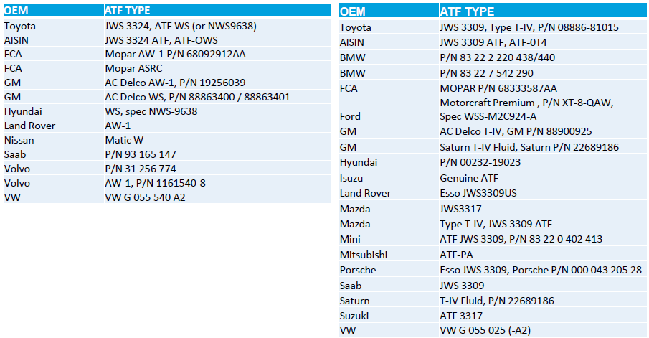
Toyota WS and T-IV ATF Family
ABC
DEF

Slide 32
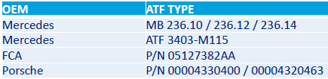
Mercedes-Benz ATF Coverage
1 MAD test with a 7-speed MB cars was conducted for 10k miles with interval evaluations comparing it with its F/F MB 236.12/236.14 ATF
  KV100 remained stable>5.9 cSt (Fresh KV100=6.4 cSt)
  No observed signs of oxidation (TAN <1.0 mg KOH/g)
  Negligible metals (Fe, Cu, Al, Pb) found in EOT fluid
  Shift feel evaluations were satisfactory

Slide 33

Chrysler ATF Coverage*
Chrysler Type 9602 (ATF+4) is back serviceable for prior Chrysler cars and OEMs using Chrysler transmissions
2 MAD tests with Chrysler cars were conducted for 20k miles with interval evaluations comparing them with the F/F Chrysler Type 9602 ATF
  KV100 remained stable>5.8 cSt (Fresh KV100=6.0 cSt)
  No observed signs of oxidation (TAN <0.8 mg KOH/g)
  Negligible metals (Fe, Cu, Al, Pb) found in EOT fluid
  Shift feel evaluations were satisfactory
  *Chevron cannot recommend Havoline Full Synthetic Multi-Vehicle ATF for ATF+2, +3 or +4 applications because it markets Havoline ATF+4 which is approved by Chrysler for these applications

Slide 34
Appendix

Slide 35
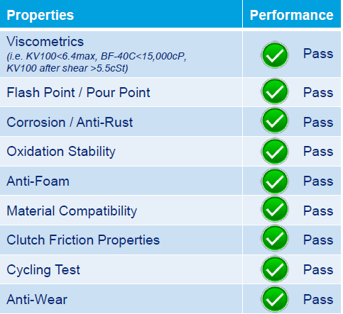
Performance Testing
Specification Testing
Field Trials
GM and Ford Approval

Slide 36
MAD & Field Trial Evaluation Overview
MAD and bench test completed at independent facilities
  Intertek and Southwest Research Institute
Hardware & fluid properties are monitored during MAD and field trials to verify performance
Viscosity
  Stable kinematic viscosity at 100C confirms fluid is shear stable and maintains proper film thickness for its drain interval
Oxidation
  Stable/negligible acid content of fluid enables clean operations and extends transmission durability
Wear protection
  Negligible metal content confirms absence of wear and corrosion elements in fluid that extend life of all moving parts
Shift feel
  Noise, vibration and hysteresis at different driving modes
Anti-shudder
  Absence of shudder at extreme driving conditions like low temperatures, low speeds, towing & high speeds

Slide 37
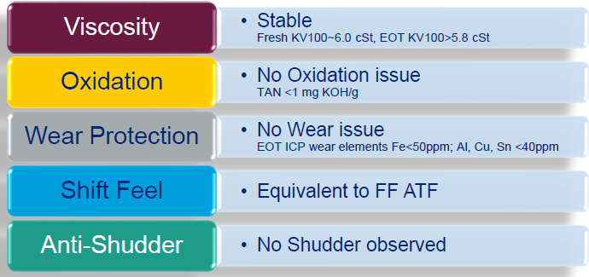
Mileage Accumulation Dynamometer (MAD) Evaluations
Highlights of mileage accumulation dynamometer tests:

Slide 38
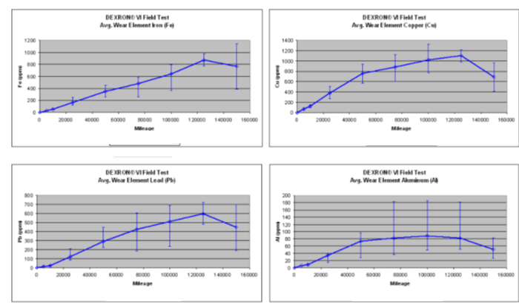
GM DEXRON-VI Field Trial - Overview
Wear at acceptable level for 150K mile field test with no oil drain
Iron (Fe) < 800 ppm (on average)
Copper (Cu) < 1,100 ppm (on average)
Lead (Pb) < 600 ppm (on average)
Tin (Sn) < 50 ppm (on average)
Aluminum (Al) < 90 ppm (on average)
Silicon (Si) < 25 ppm (on average)
Source: Field trial and internal analysis

Slide 39
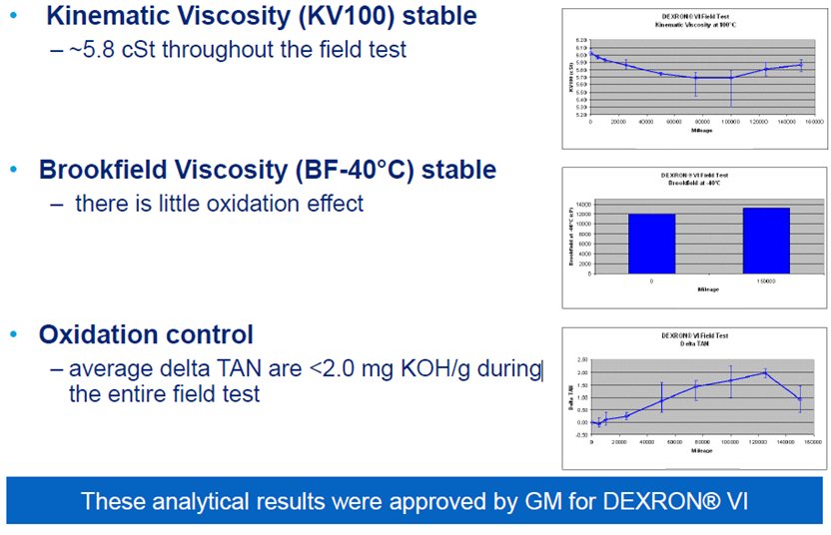
GM DEXRON-VI Field Trial: Oil Analysis
Source: Field trial and internal analysis

Slide 40
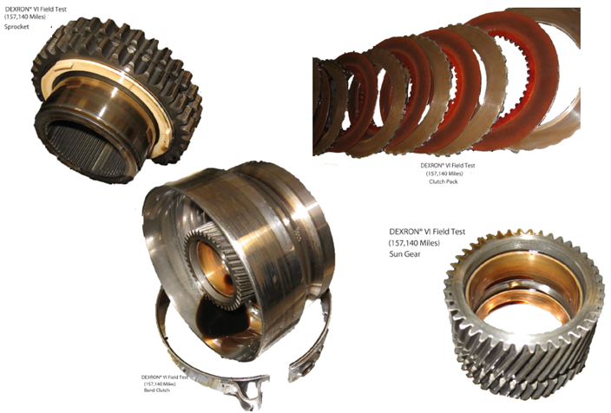

GM DEXRON-VI Field Trial: EOT Inspections by GM
Wear | Havoline Full Synthetic Multi-Vehicle ATF
Reverse Band
Rev Band Housing
2nd Clutch
Fwd Band
Input Clutch Piston
Pump Shaft Spline
2-1 Manual Band
Input Bearing
Thrust Washers
Input Drum
Reaction Carrier Pinions

Slide 41
Ford MERCON LV Field Trial Overview
Wear at acceptable level for 150K mile field test with no oil drain
Iron (Fe) < 150 ppm (on average)
Copper (Cu) < 50 ppm (on average)
Lead (Pb) < 1 ppm (on average)
Aluminum (Al) < 50 ppm (on average)
Source: Field trial and internal analysis

Slide 42
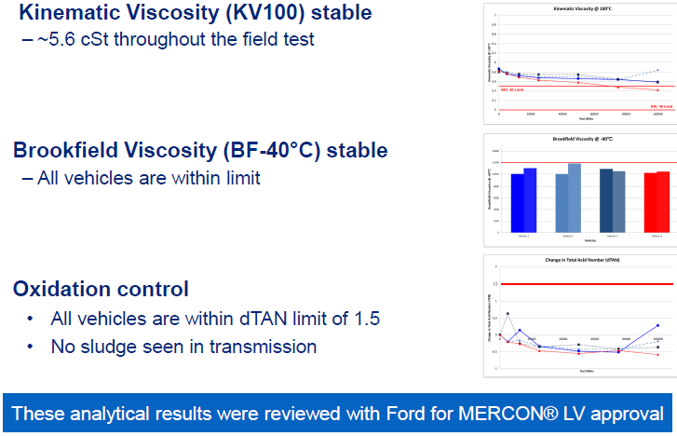
Ford MERCON LV Field Trial: Oil Analysis
Source: Field trial and internal analysis

Slide 43
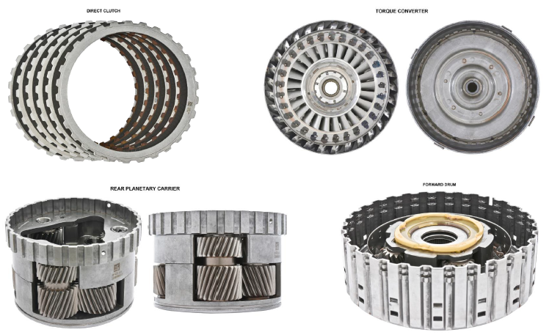
Ford MERCON-LV Field Trial: EOT Inspections

