Slide 1
DELO® SYN ATF™ 668
Approved by Allison for TES 668™ standard
December 2021
Customer name
Name of presenter
Title of presenter
presenteremail@chevron.ca

Slide 2

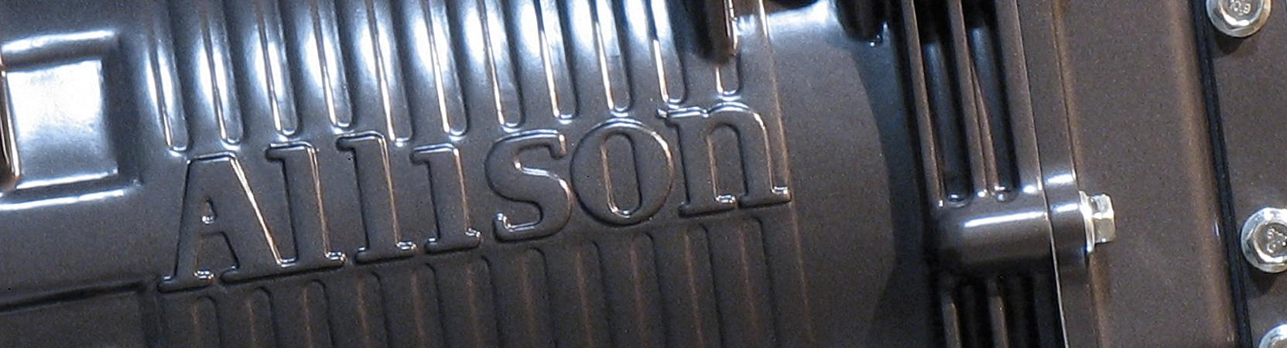
DELO SYN ATF 668
Full synthetic formulation
Approved by Allison Transmissions®
Specifically engineered for Allison transmissions that specify TES 668™ fluids
Specified for Allison 1000 Series™, 2000 Series™, 3000 Series™, 4000 Series™, H 40/50 EP™, and eGen Flex™, Series on-highway products
Backwards compatible with TES 295®, TES 389® and TES 468® fluids

Slide 3

BUILDING ON PROVEN PERFORMANCE
Extended anti-shudder durability for smooth steady operation
Extended clutch friction durability for consistent gear changes
Superb oxidation performance for extended drains
Excellent gear protection for long transmission service life

Slide 4
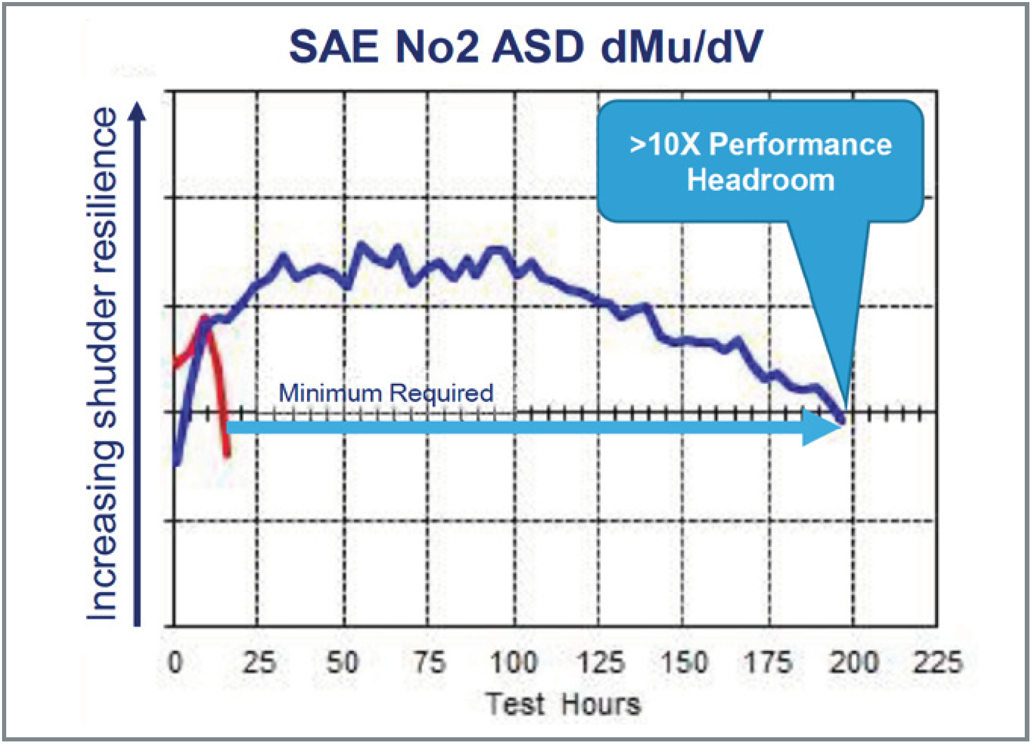

EXTENDED ANTI-SHUDDER DURABILITY
Formulated to improve durability and prolong equipment life
Protects against friction deterioration over time, decreasing vibrations and optimal drivability
Maintains shudder reduction, even as the fluid ages (see test results)

Slide 5
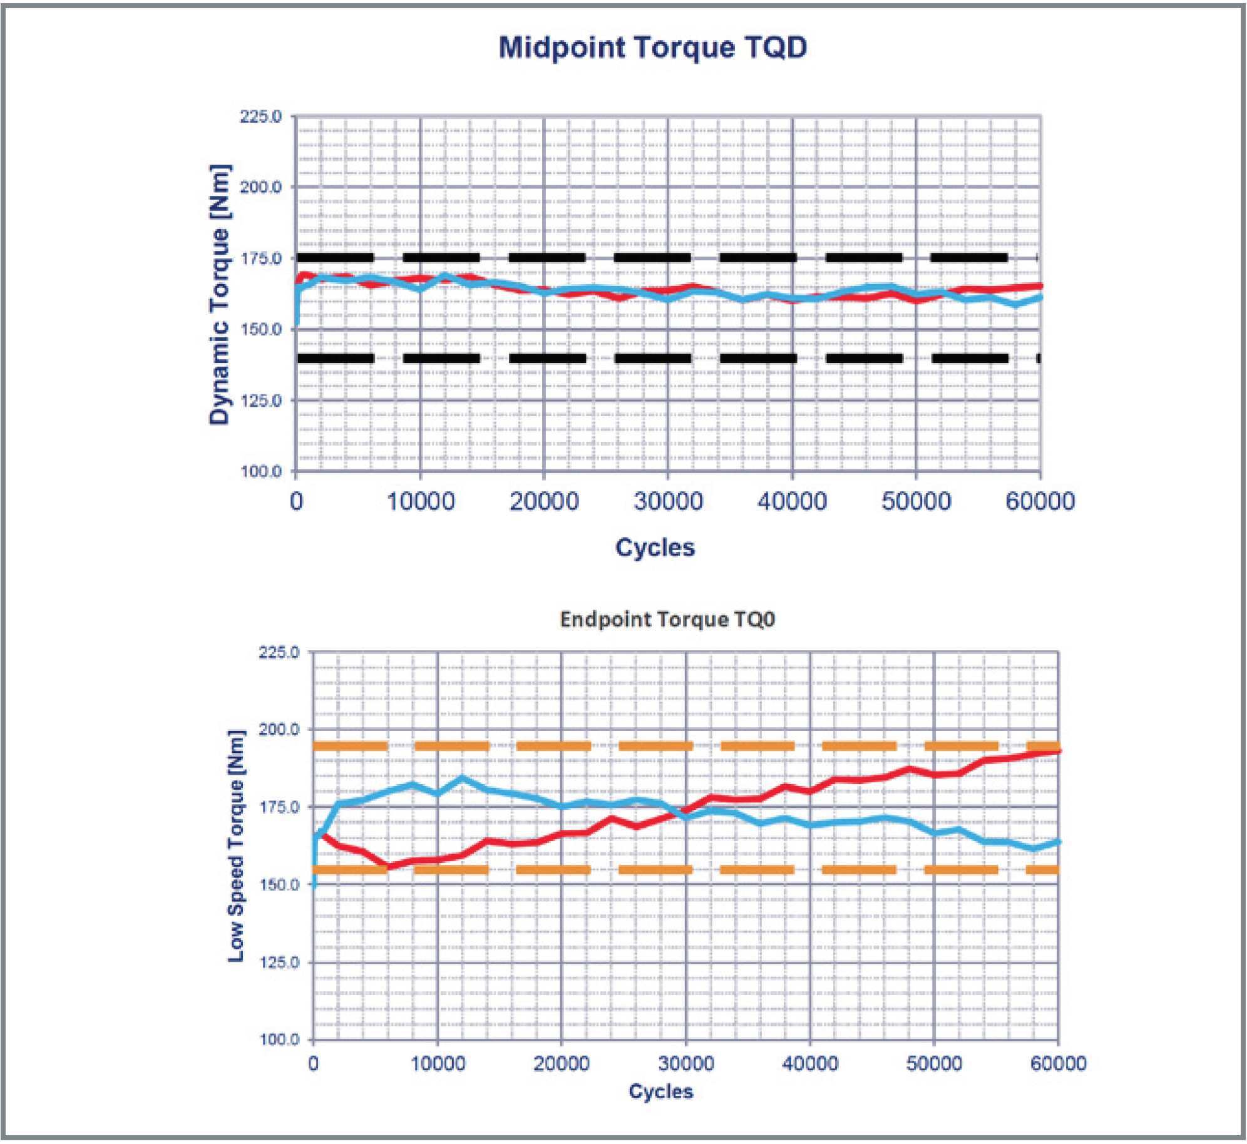
EXTENDED CLUTCH FRICTION DURABILITY
Ensures consistent shift performance by minimizing friction degradation
Effective regardless of driving operation

Slide 6
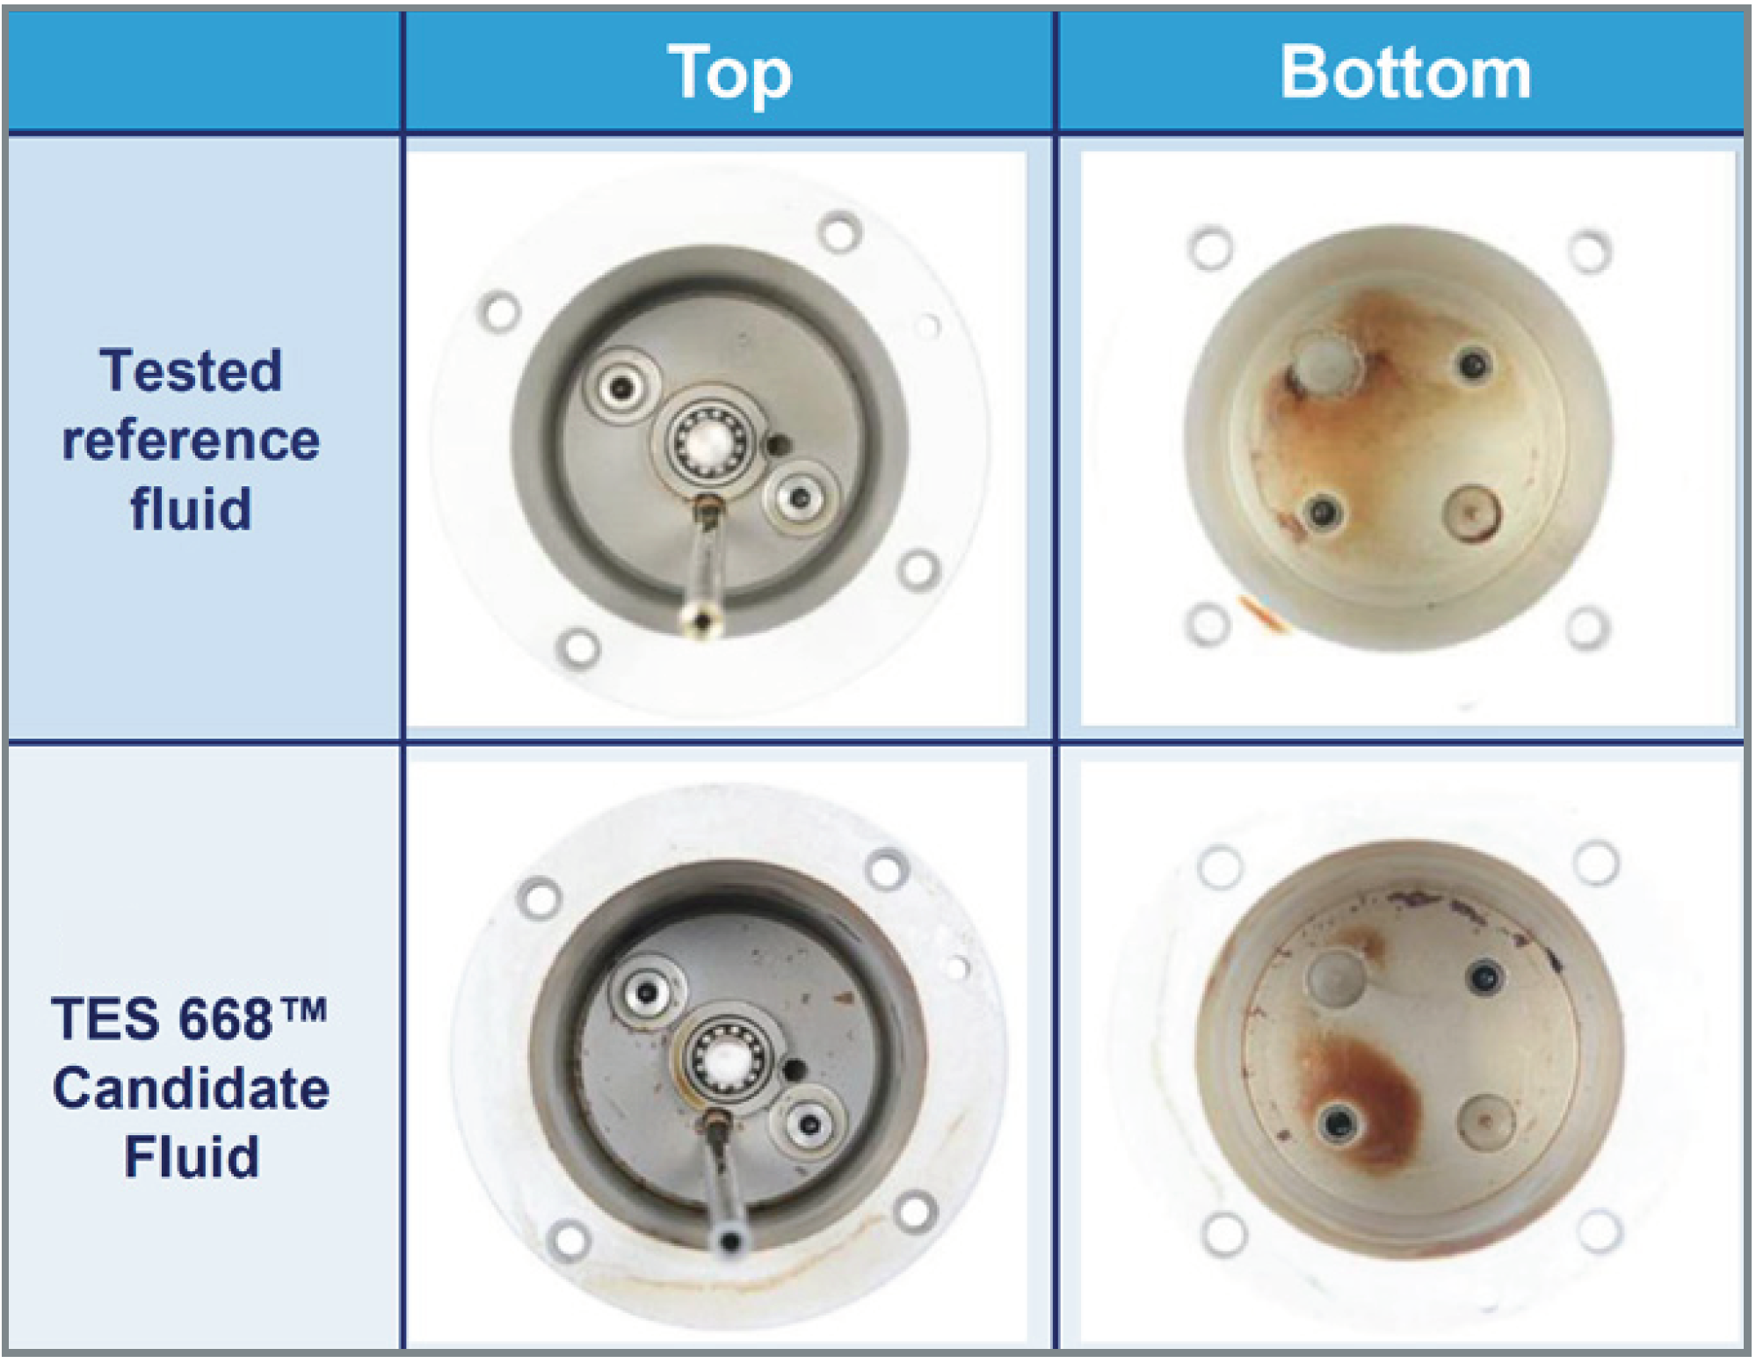
SUPERB OXIDATION PERFORMANCE FOR EXTENDED DRAINS
Extends drain intervals without sacrificing performance
Made with boosted antioxidants to help prevent oxidation, prolonging equipment life

Slide 7
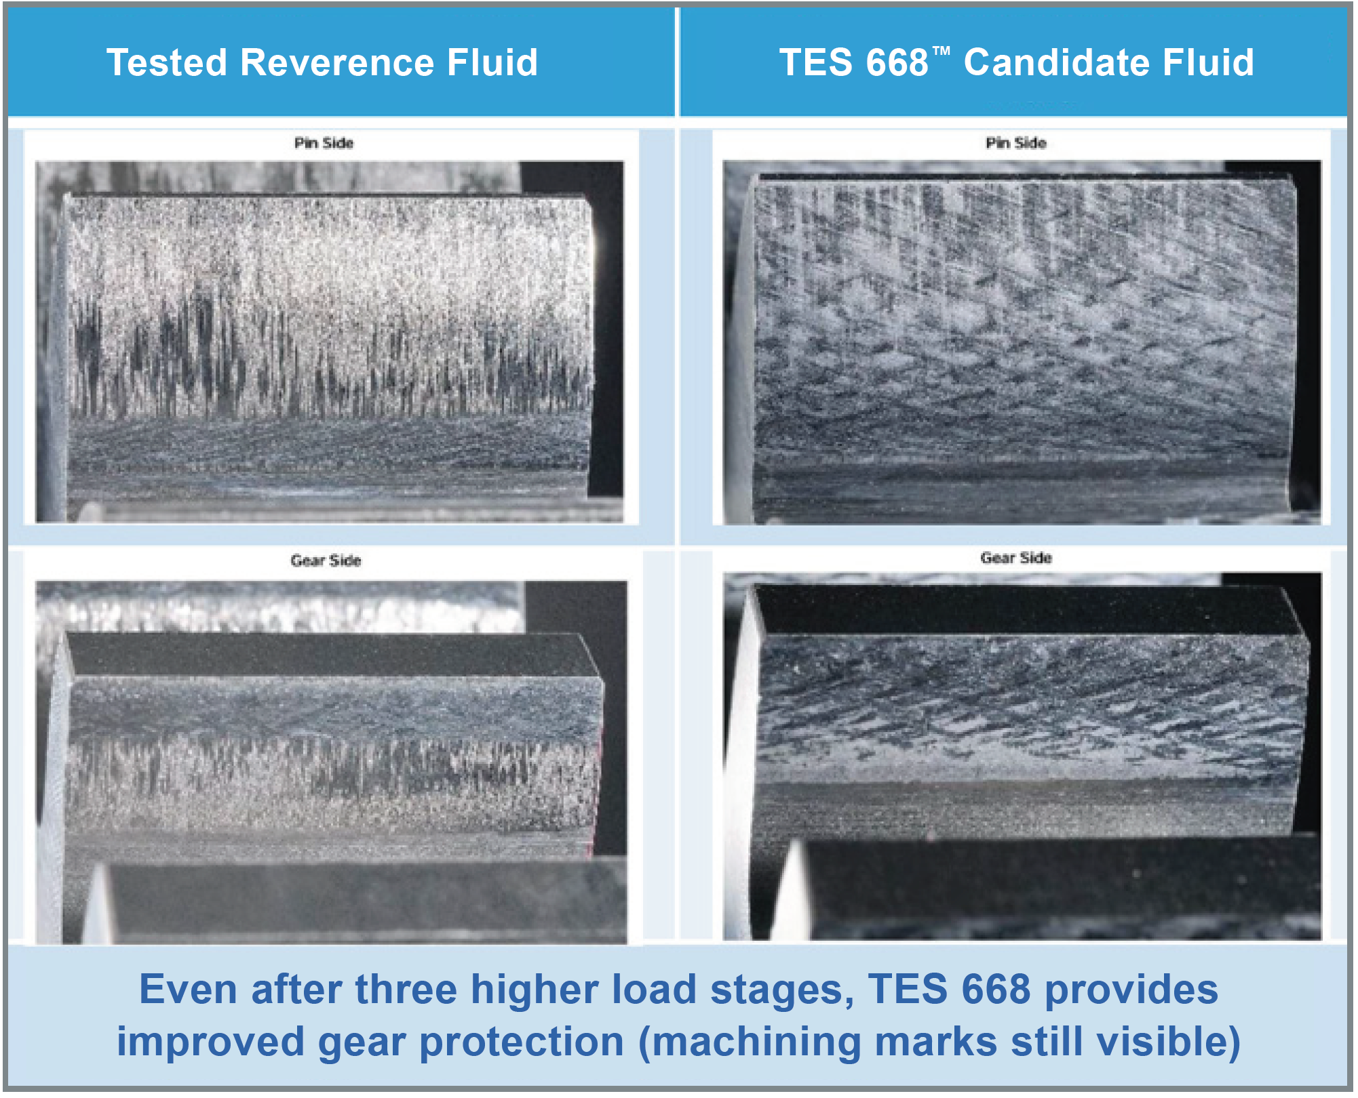
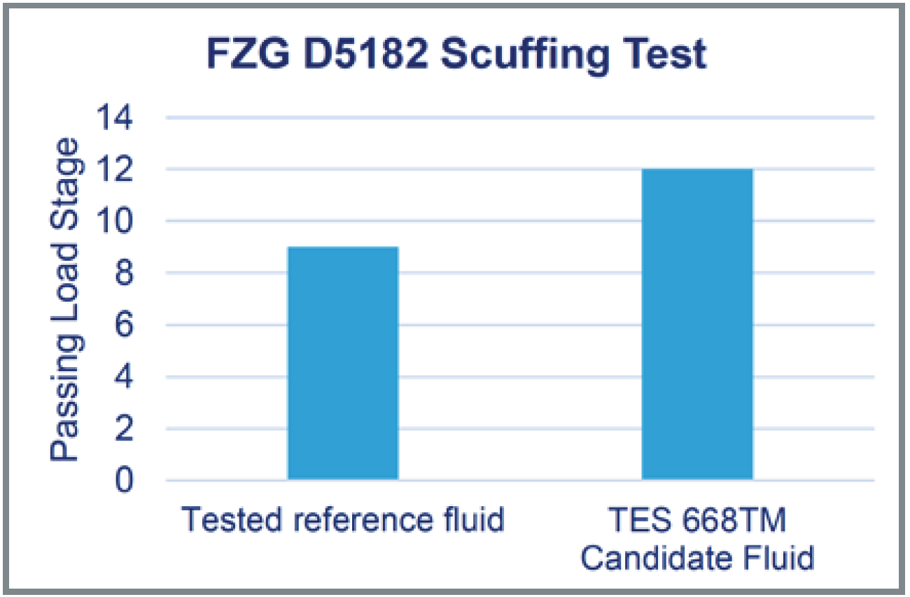
EXCELLENT GEAR PROTECTION FOR LONG TRANSMISSION SERVICE LIFE
Prolongs service life by protecting the gears
Delivers verifiable antiwear protection (see test results)

Slide 8
THANK YOU
Always follow OEM recommendations. The data contained herein is current at the time of publication <July 2021> but may change at any time. Check with OEM for updated information.

